Slide 1





Frito Lay
Employee Attrition
Case Study
By: Koosha Tabesh
Fall 2025

Slide 2

Project Goals
Identify key factors contributing to employee attrition.
Evaluate the predictive accuracy of the attrition model.
Analyze the financial impact of attrition prediction.

Slide 3
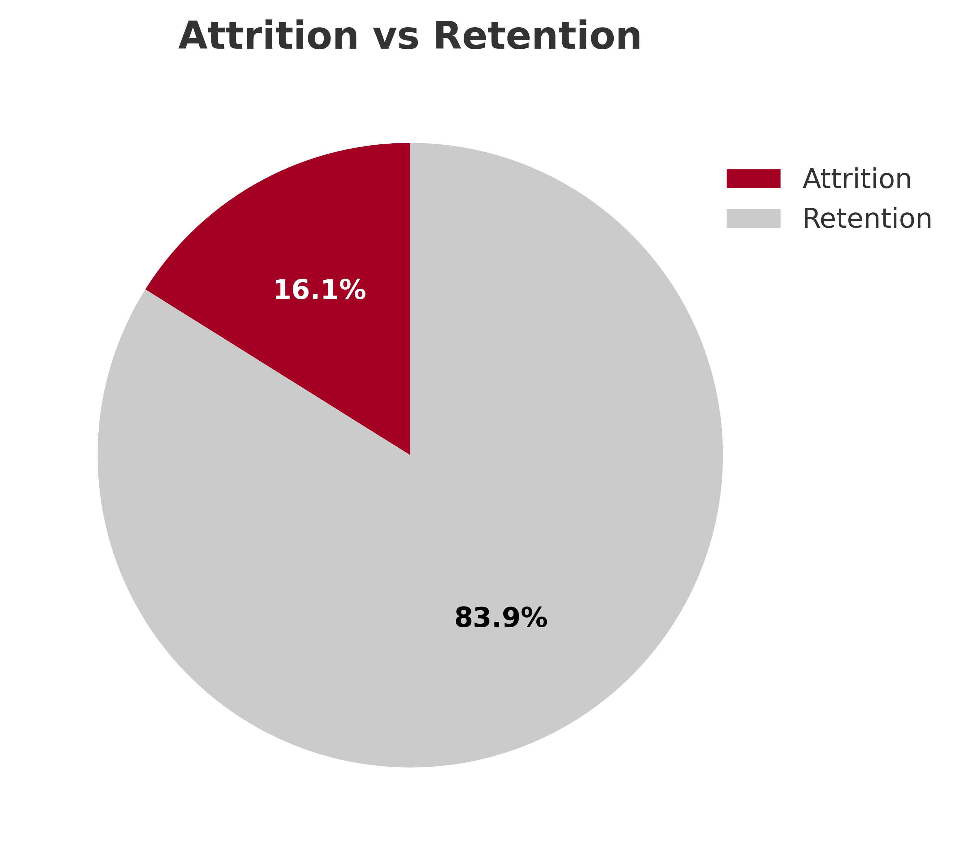
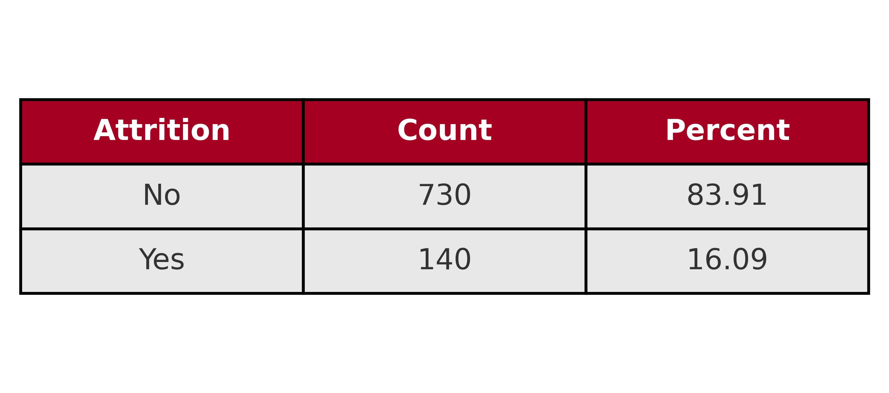
Attrition Summary

Slide 4
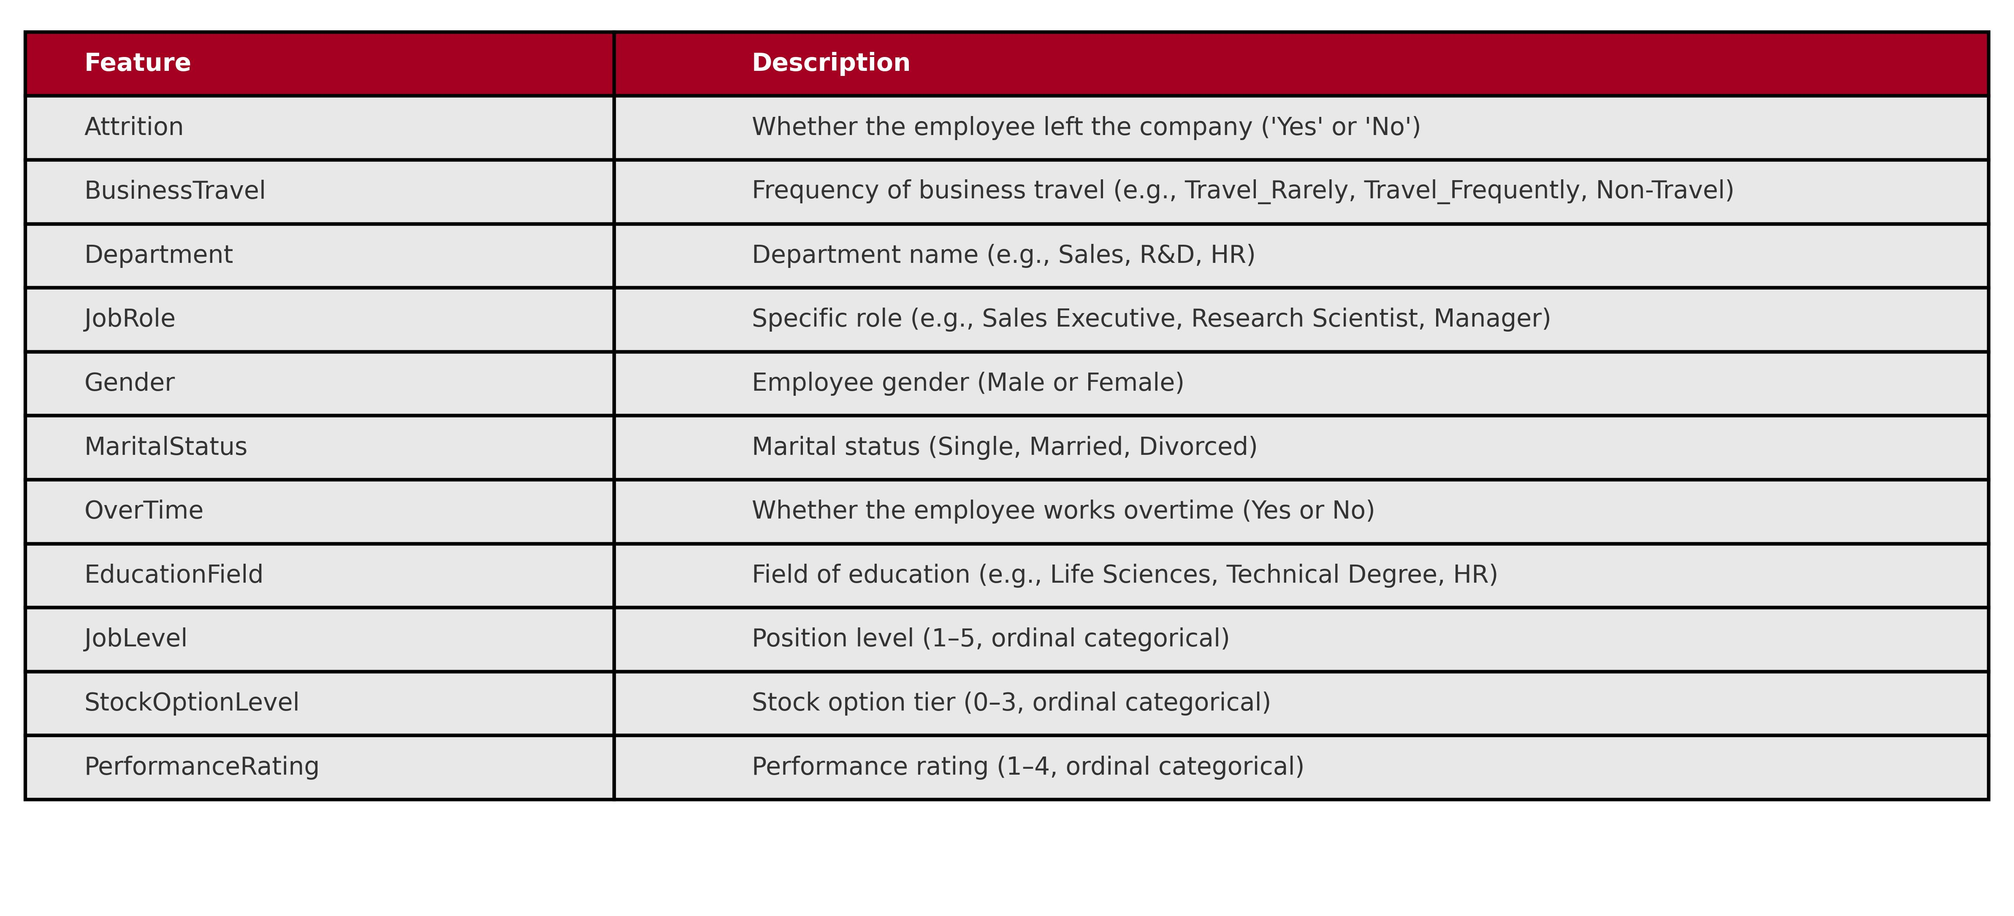
Exploratory Data Analysis
Categorical Features Dictionary

Slide 5
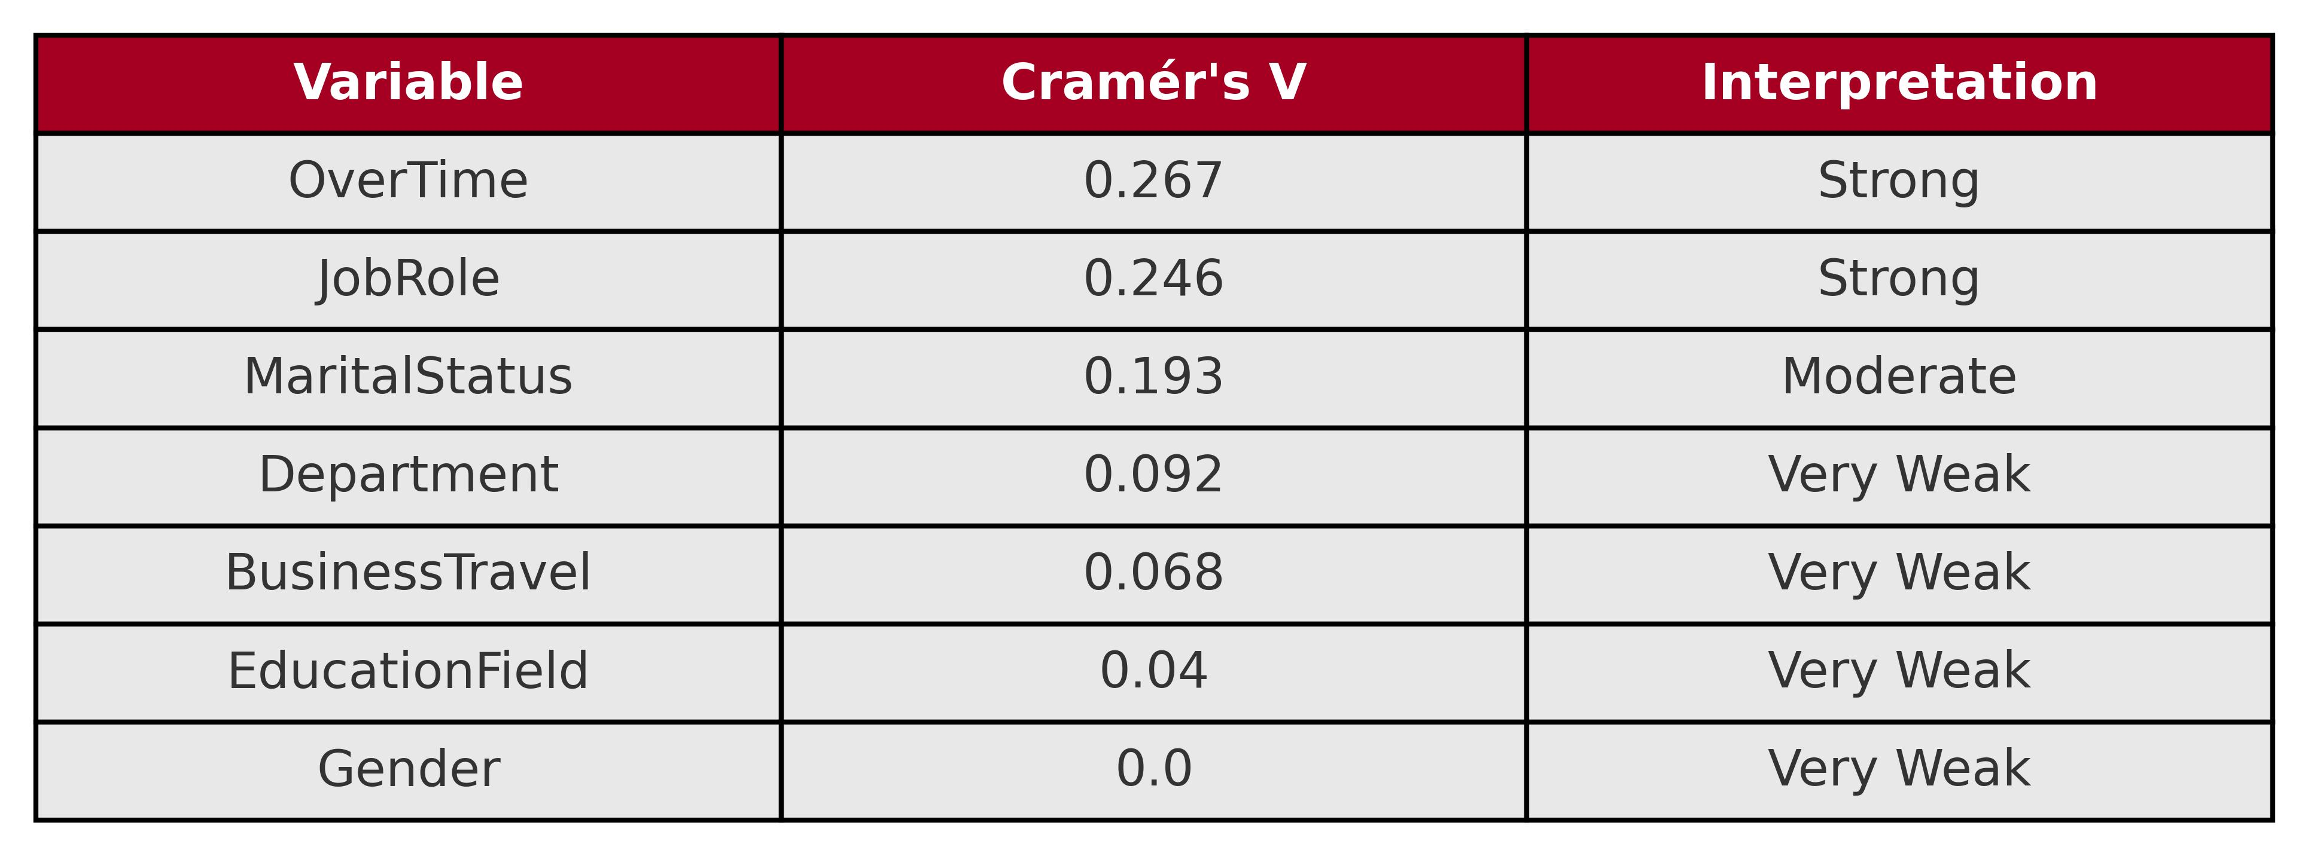
Exploratory Data Analysis(Categorical Features)
Cramér’s V → measures strength of association between two categorical variables
Range: 0 = no relationship ‖ 1 = perfect relationship
Use: identifies how strongly each categorical factor relates to attrition

Slide 6
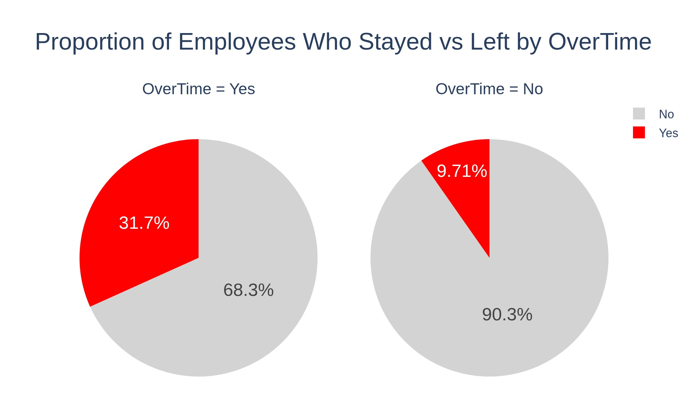
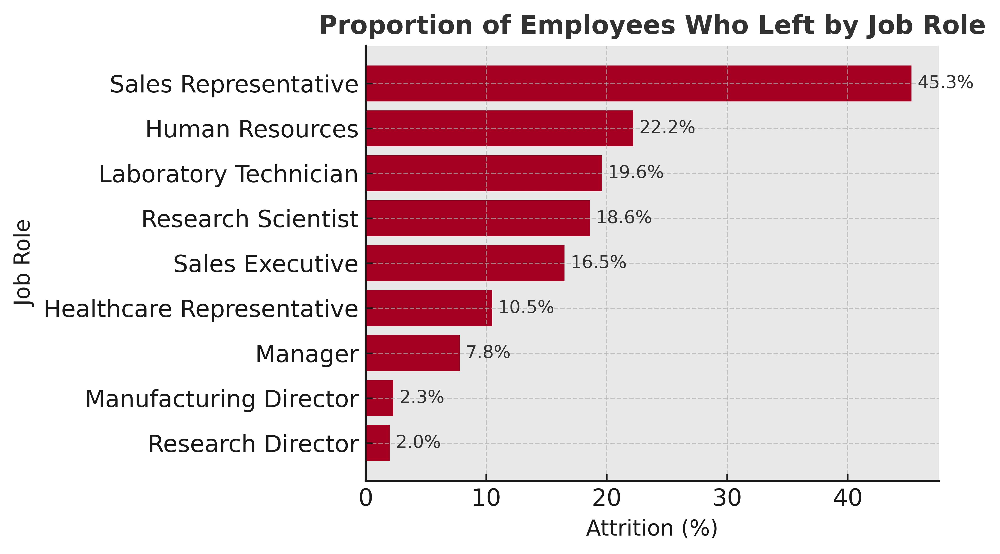
EDA (Categorical Features-Most Related)

Slide 7
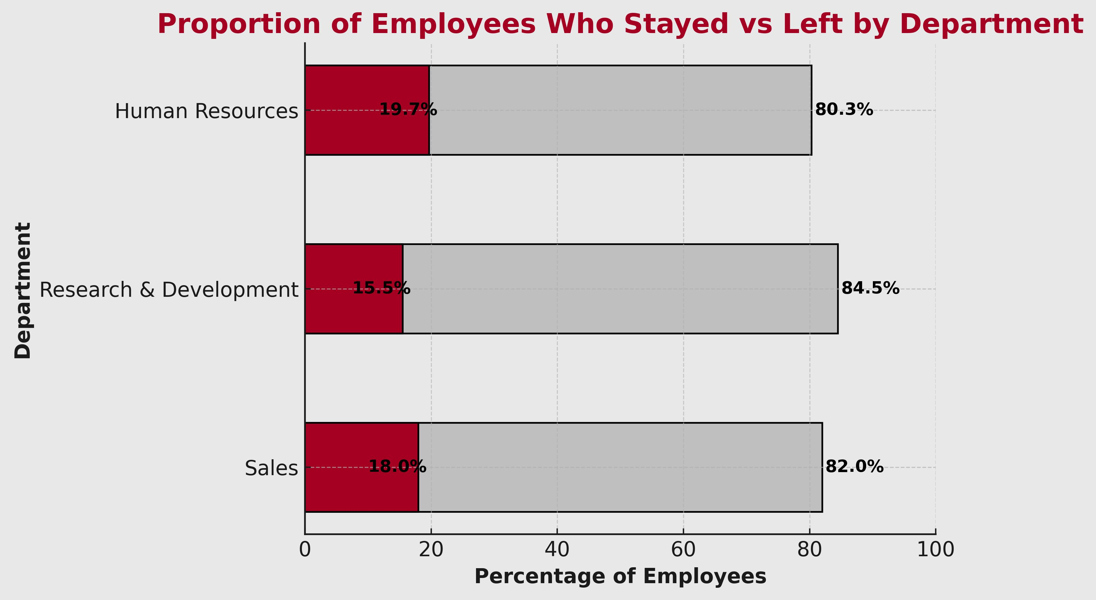
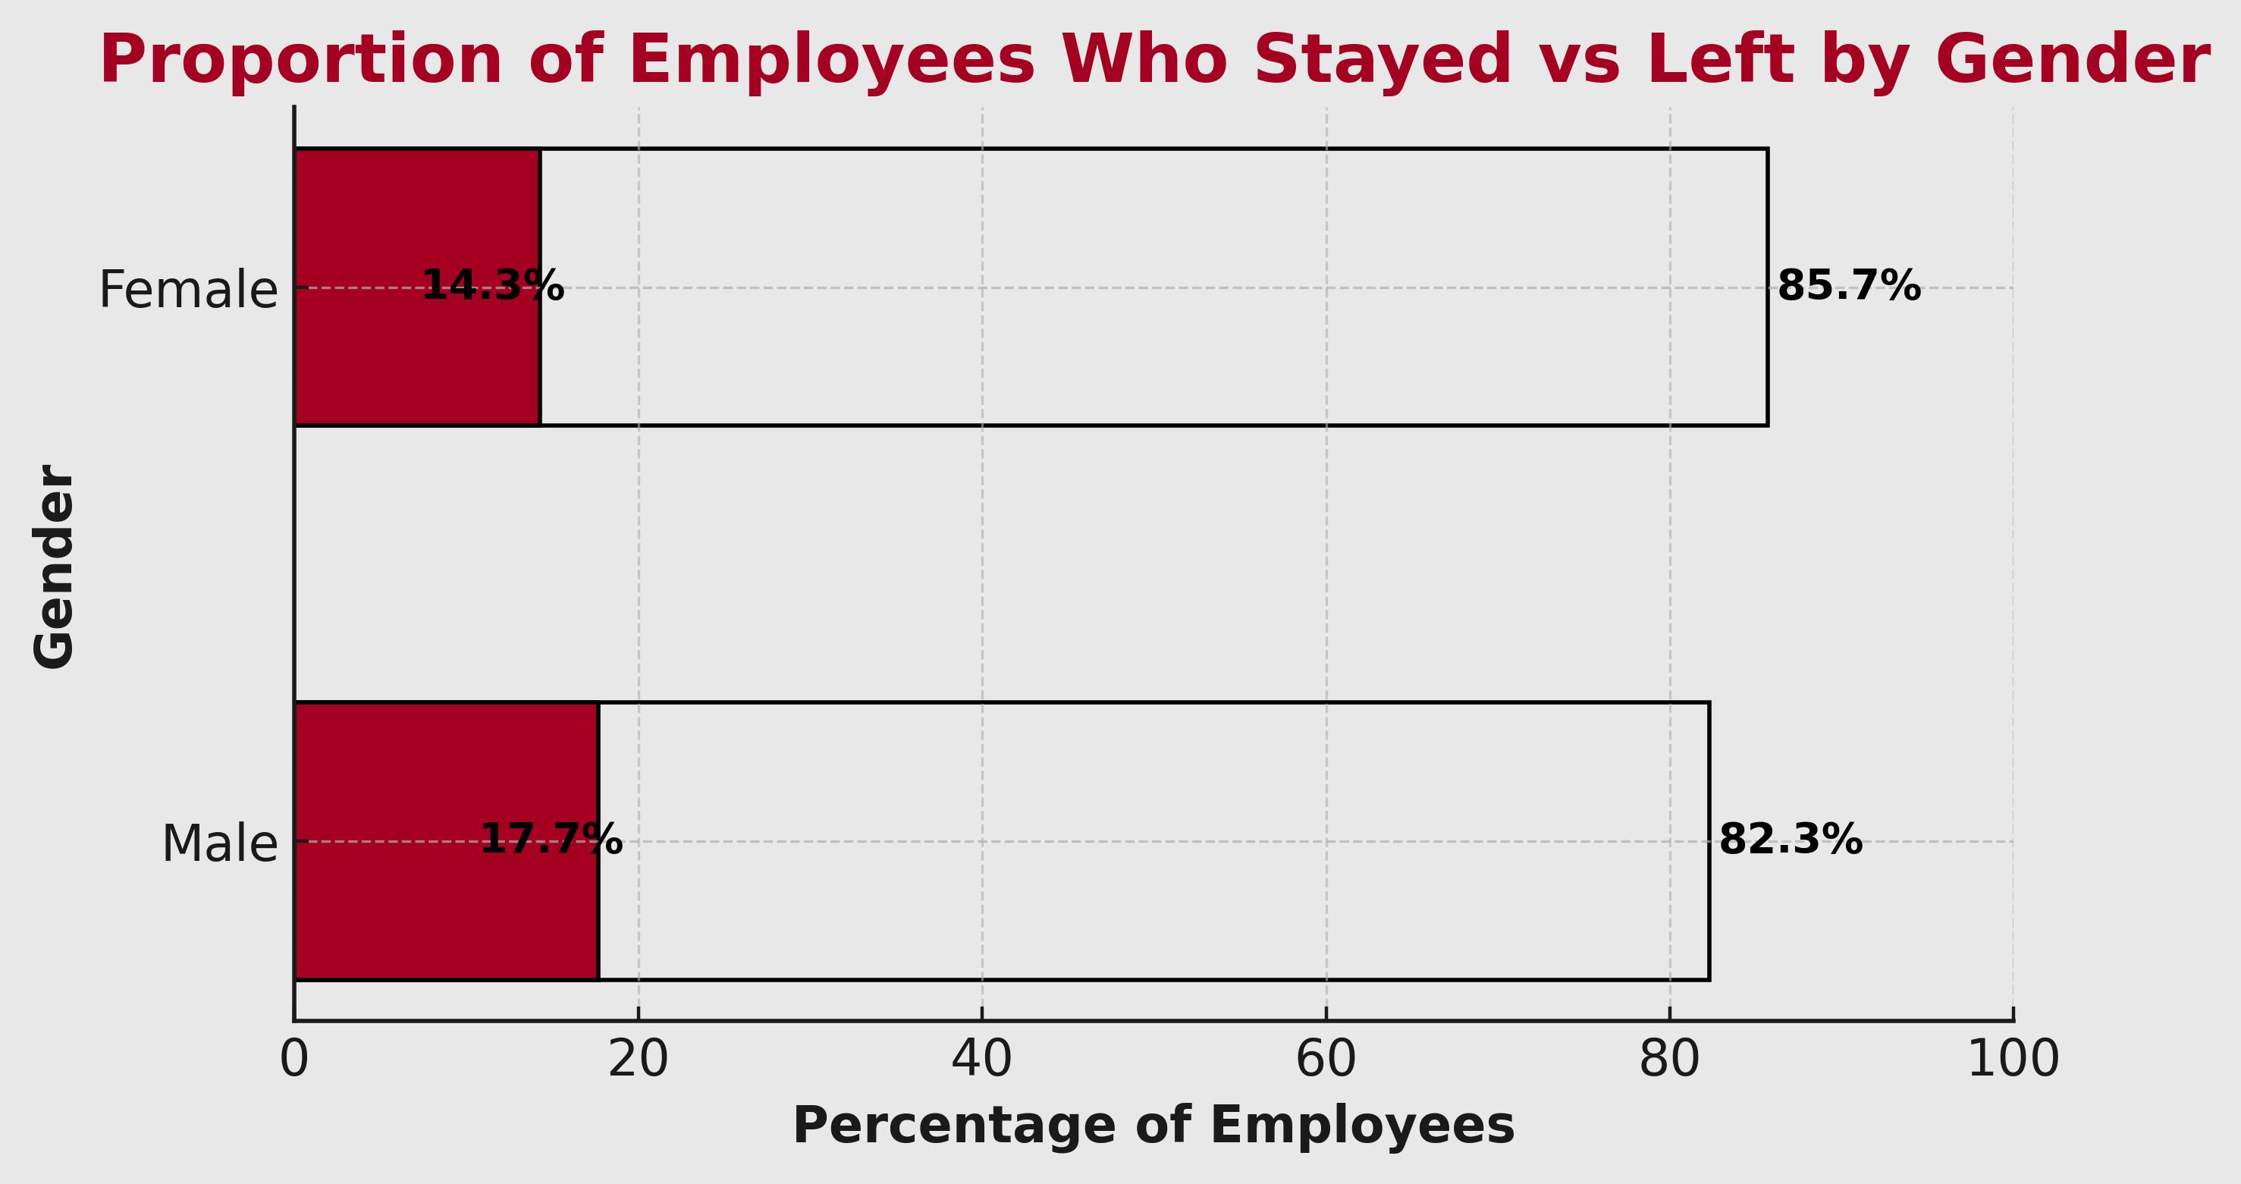
EDA (Categorical Features-Least Related)

Slide 8
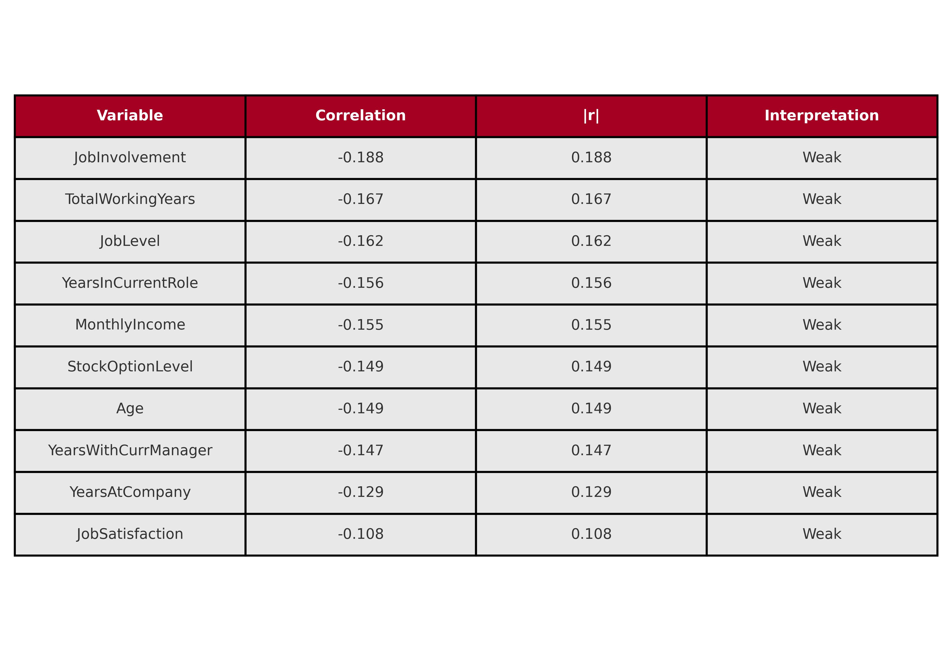
Exploratory Data Analysis(Numerical Features)

Slide 9
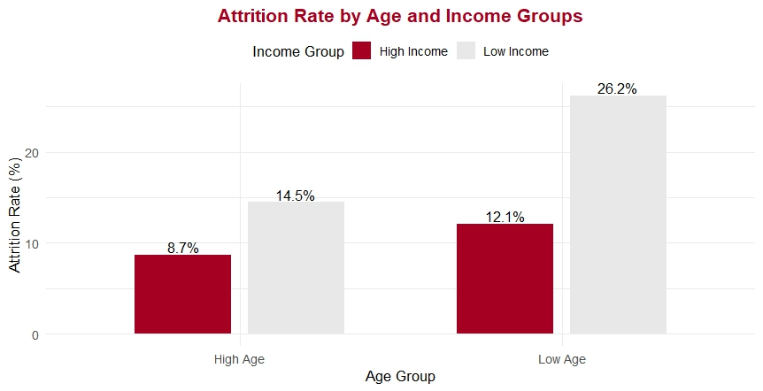
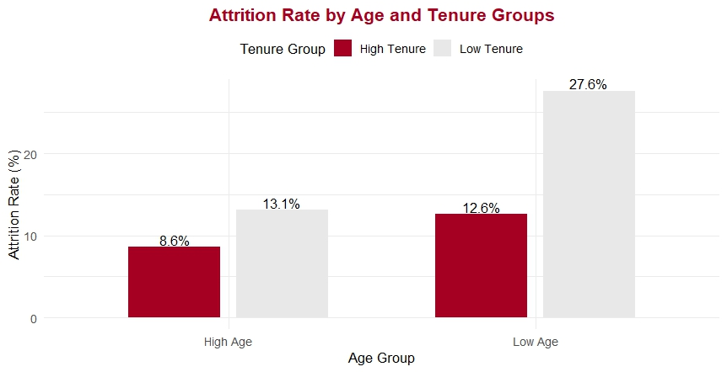
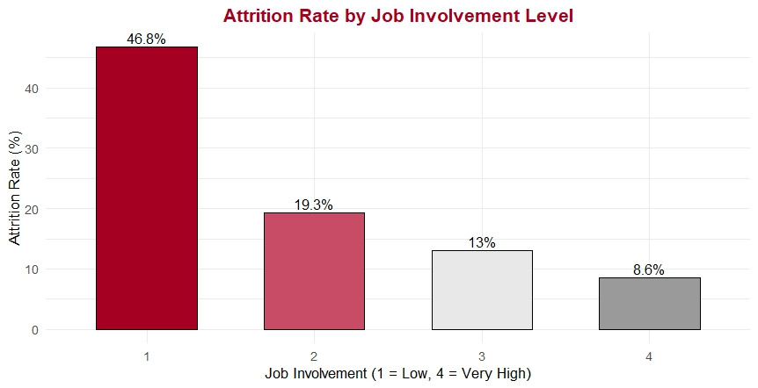
EDA (Numerical Features-Most Related)

Slide 10

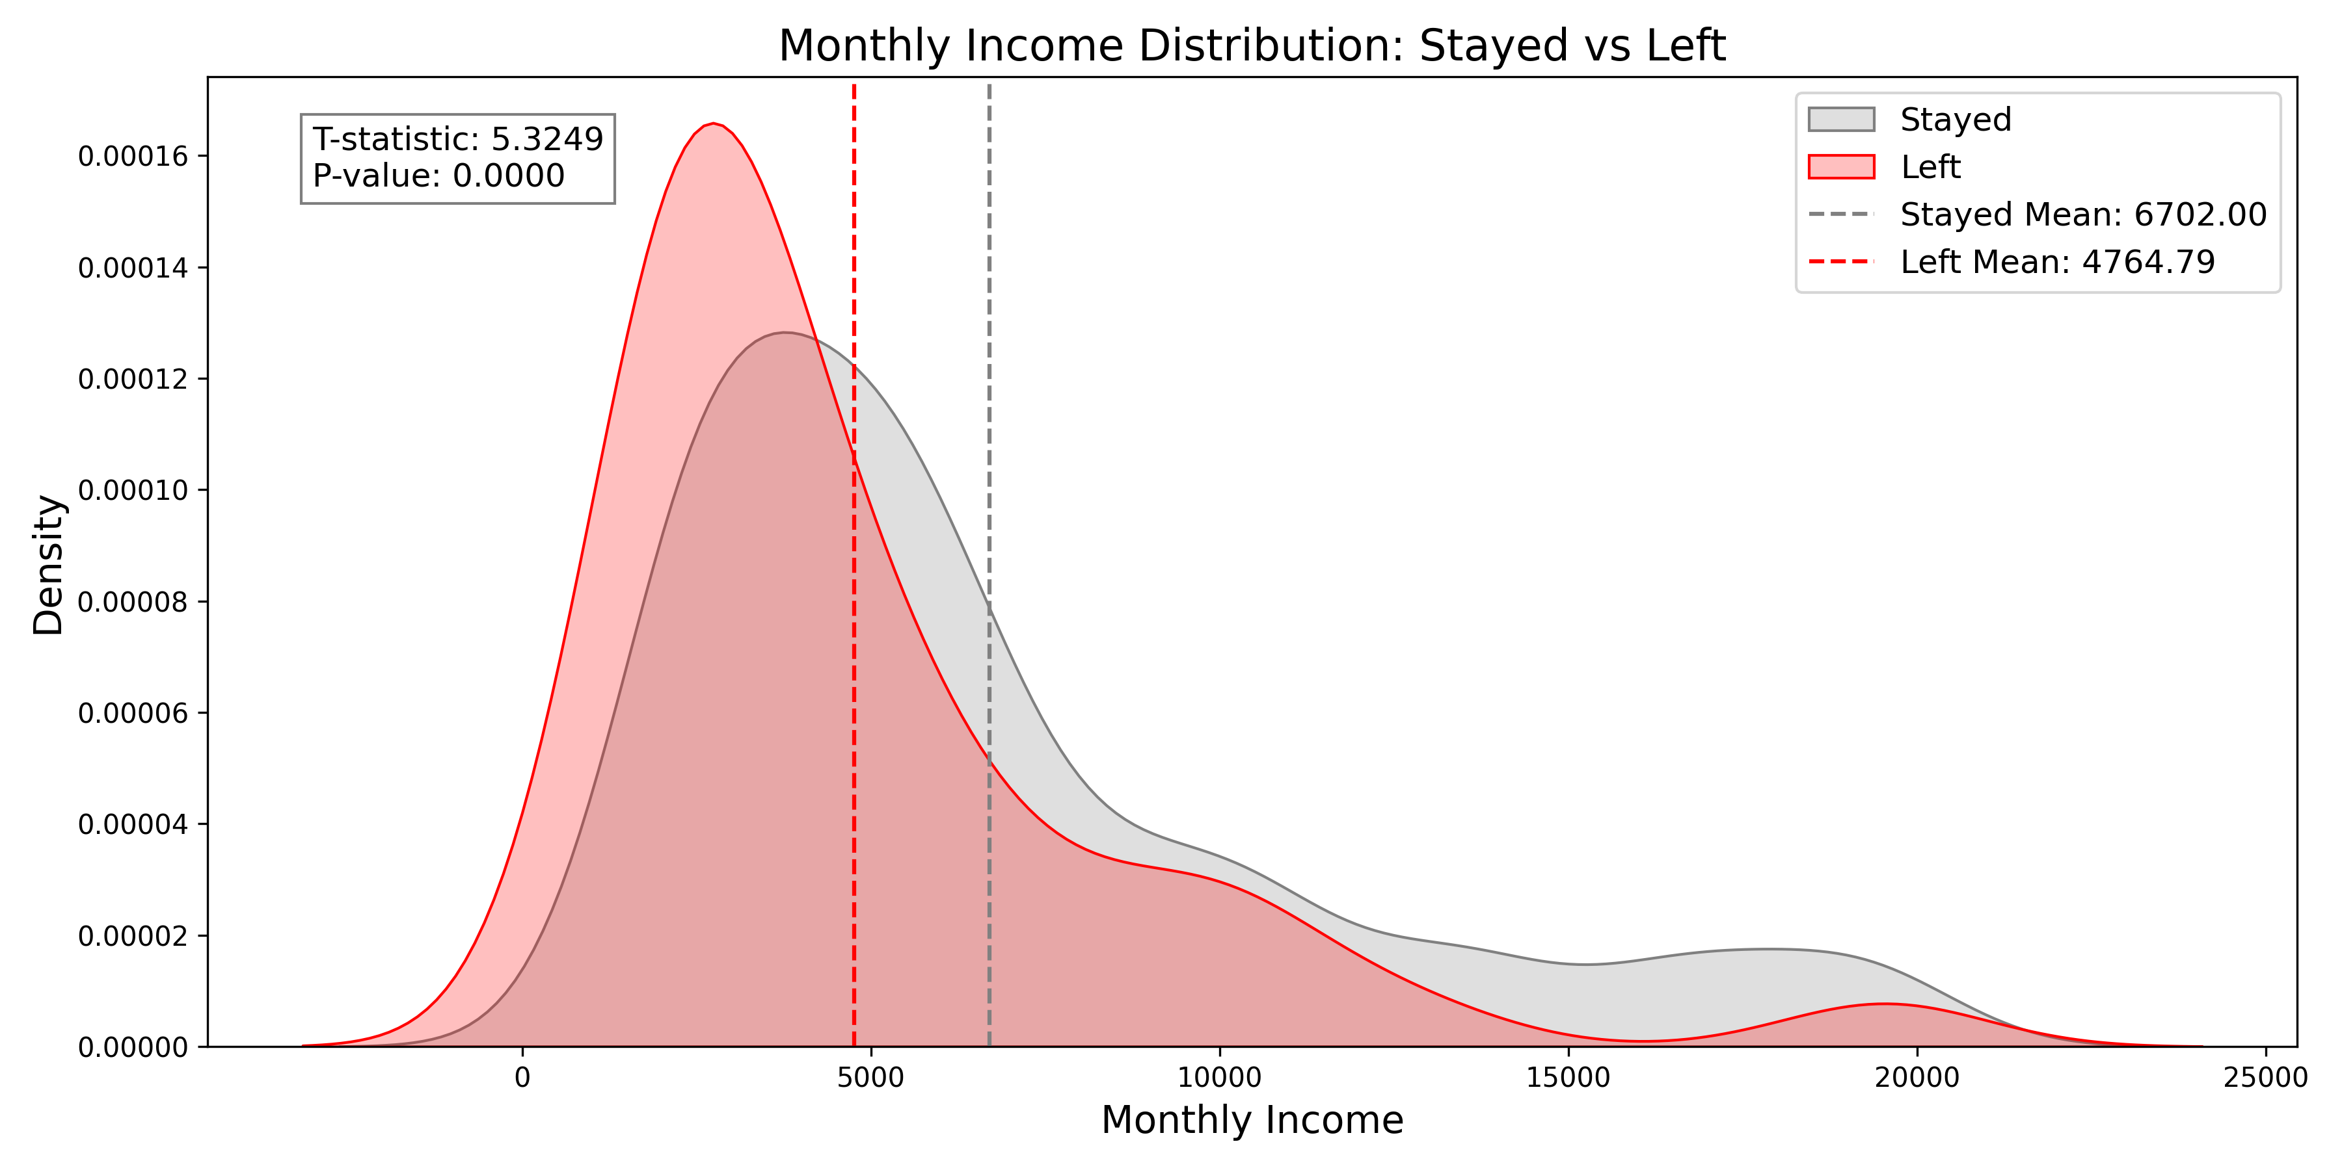

Normal Distribution Comparison and T-Test Summary
Conclusion: There is strong statistical evidence that the average Monthly Income of employees who stayed is significantly higher than that of those who left (t-test, p < 0.05).

Slide 11
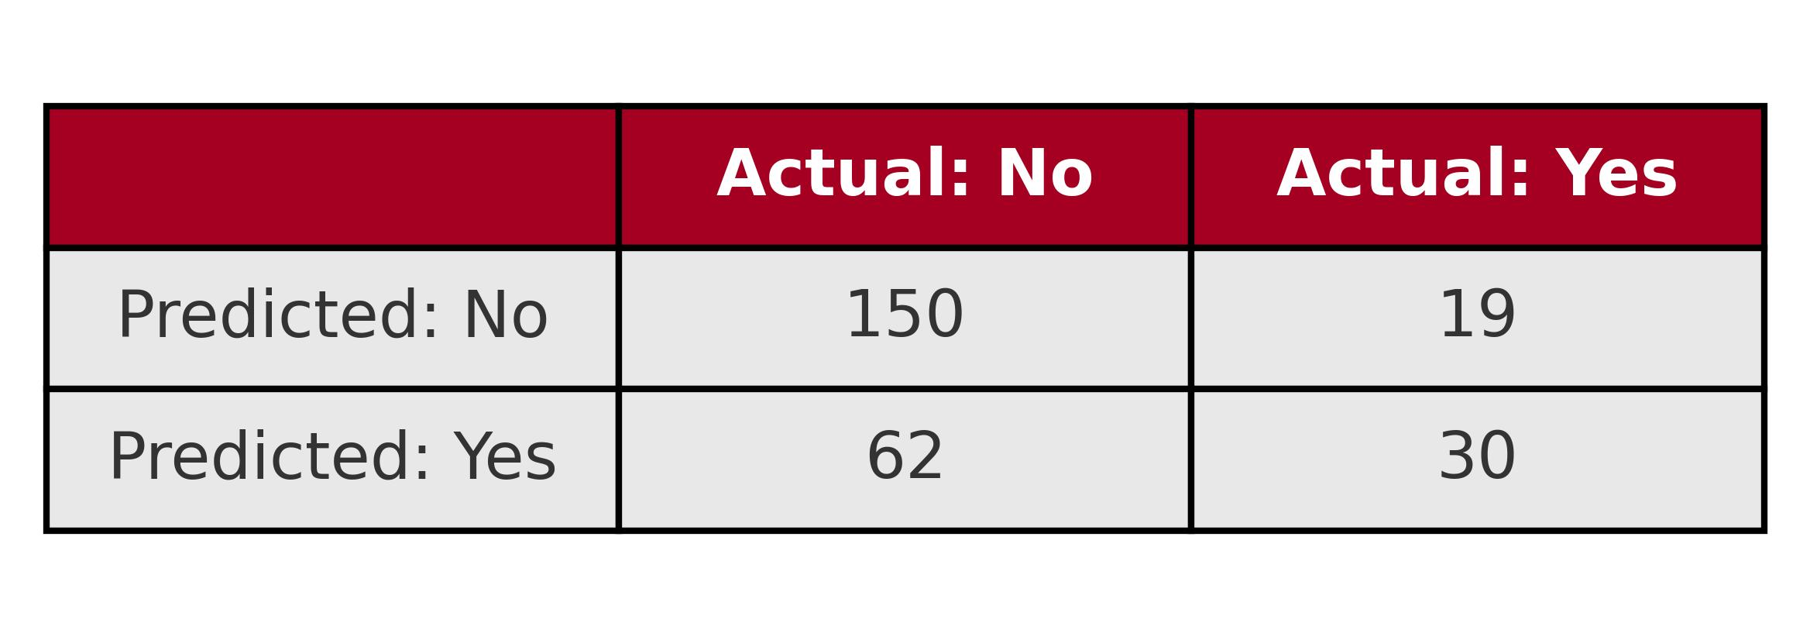
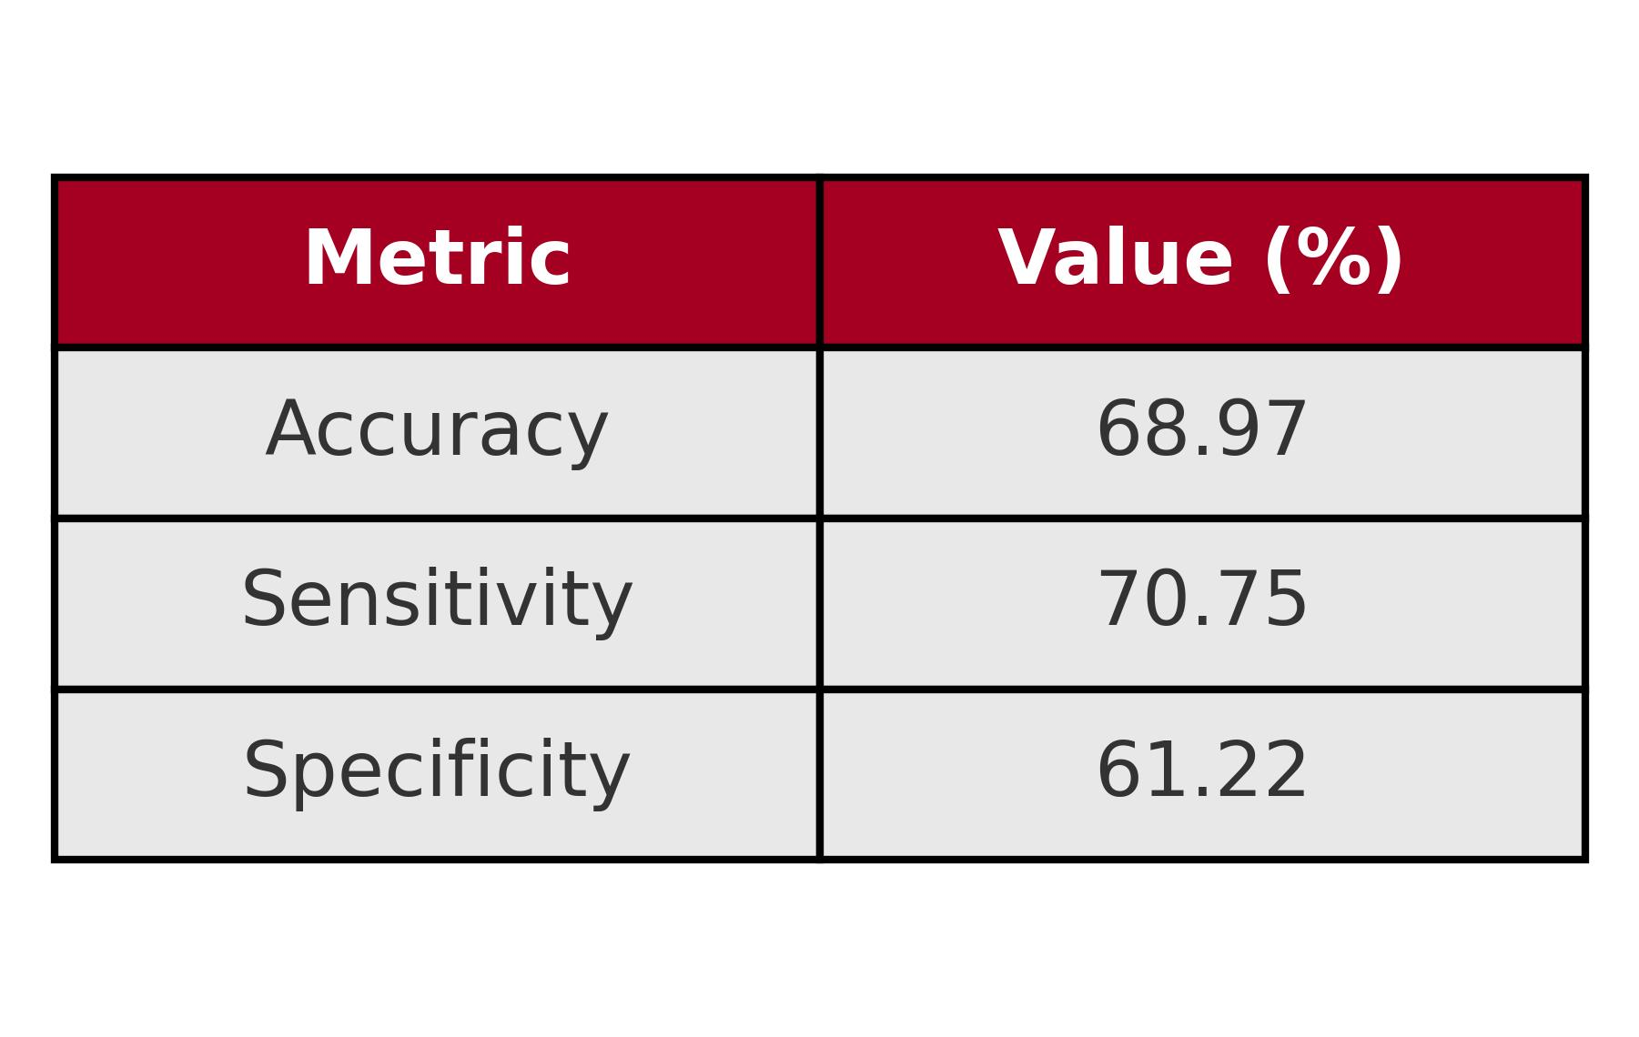
Attrition Model-Naive Bayes
Performance Summary
Accuracy
(TP + TN) / (TP + TN + FP + FN)
(150 + 30)/(150 + 30 + 19 + 62)= 68.97%
Ability to correctly identify employees who stayed(Sensitivity)
TP / (TP + FN)
150 / (150 + 62) = 70.75%
Ability to correctly identify employees who left(Specificity)
TN / (TN + FP)
30 / (30 + 19) = 61.22%
Predictors

Slide 12
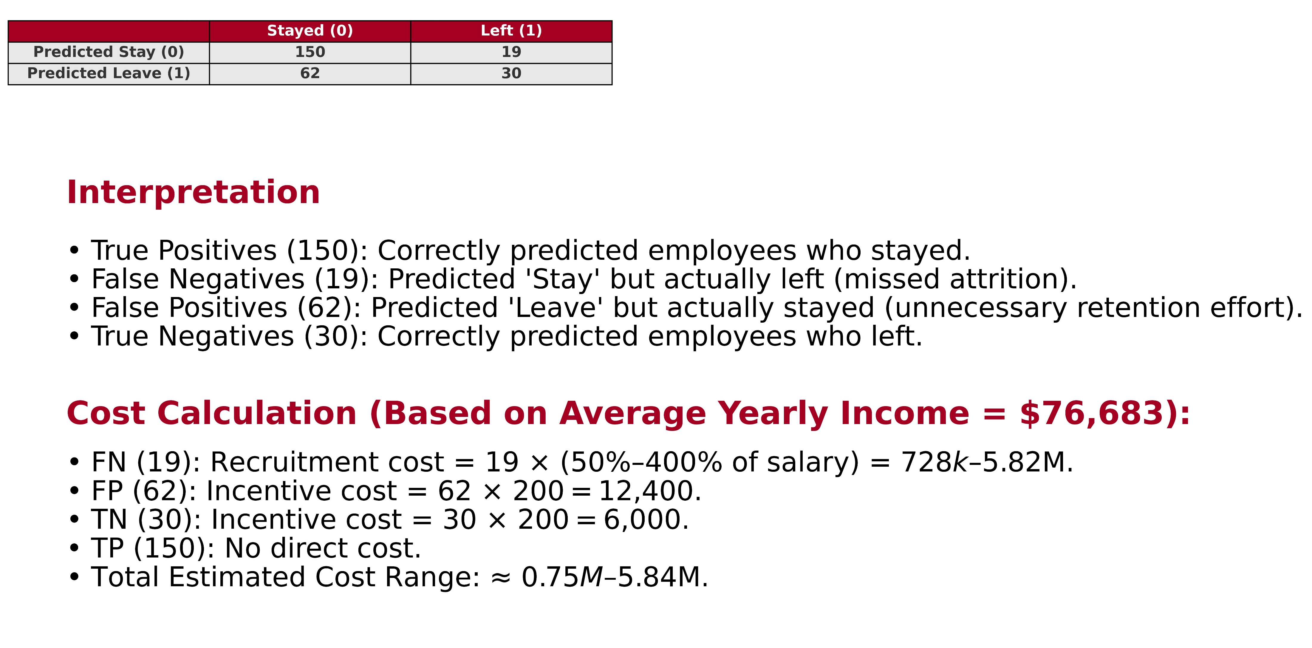
Cost Calculation-Naive Bayes Model

Slide 13
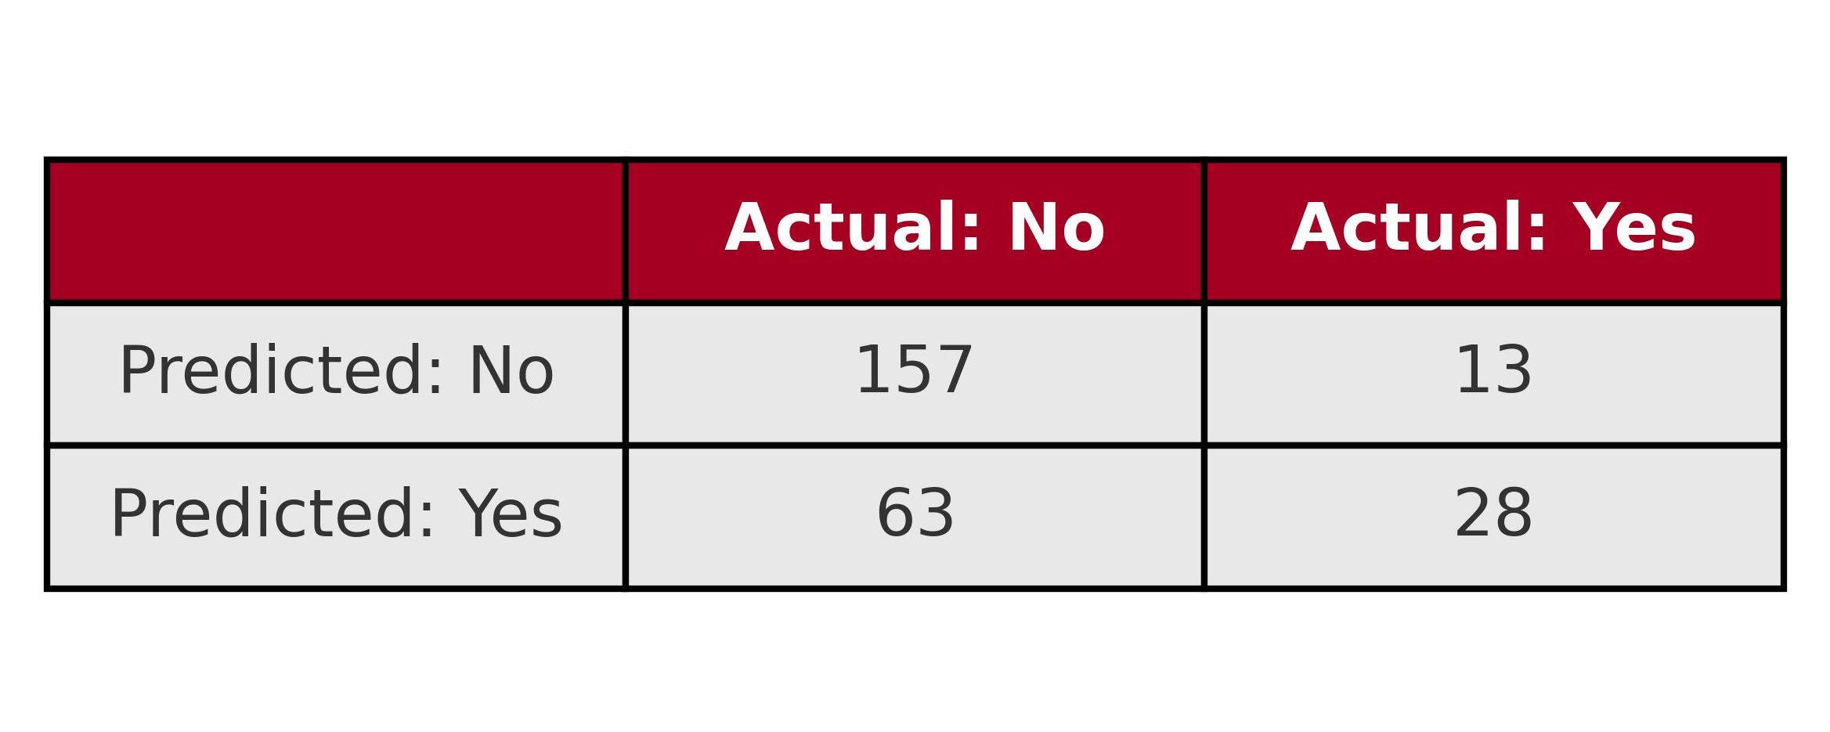
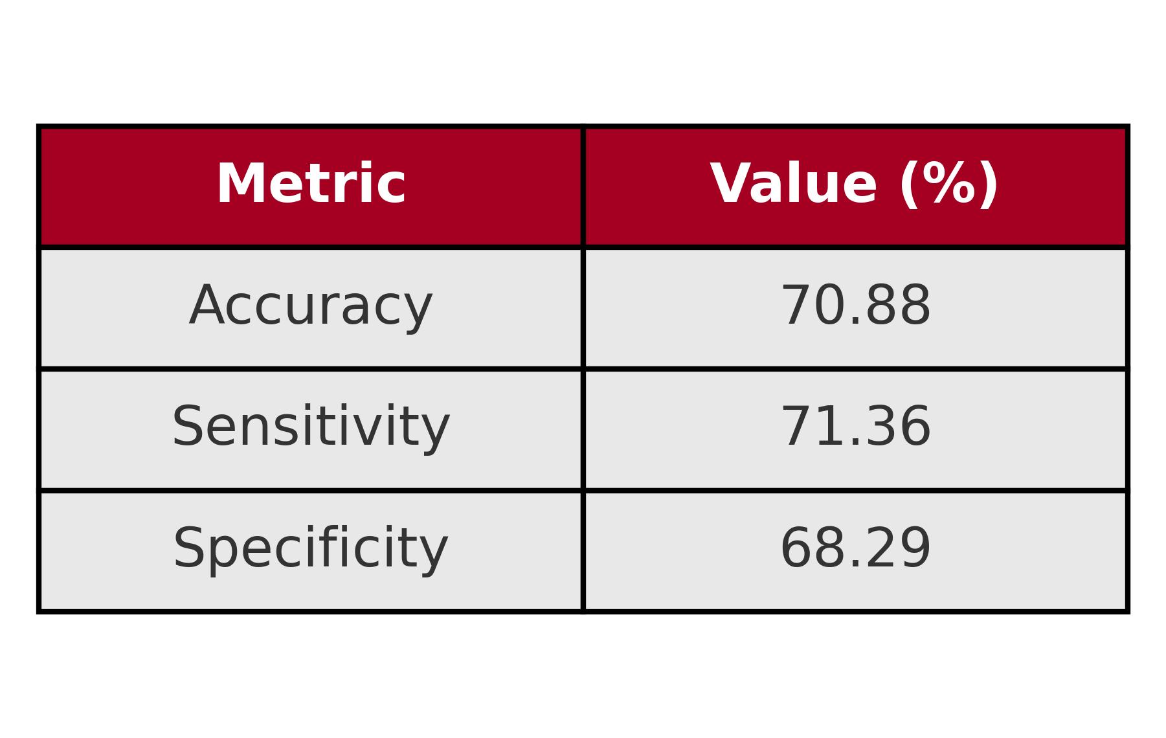
Attrition Model-KNN
Performance Summary
Accuracy
(TP + TN) / (TP + TN + FP + FN)
(157 + 28) / (157 + 28 + 13 + 63)= 70.88%
Ability to correctly identify employees who stayed(Sensitivity)
TP / (TP + FN)
157 / (157 + 63) = 71.36%
Ability to correctly identify employees who left(Specificity)
TN / (TN + FP)
28 / (28 + 13) = 68.29%
Predictors

Slide 14
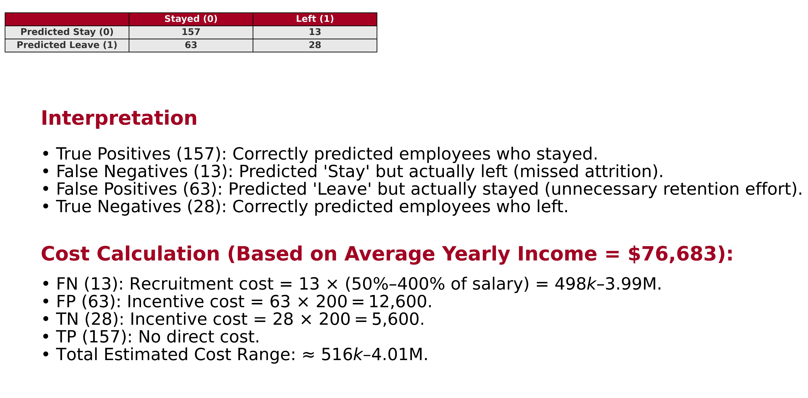
Cost Calculation – KNN Model

Slide 15
Performance & Cost Trade-Offs
MODEL | KNN | NAIVE BAYES
ACCURACY | 70.88 | 68.97
SENSITIVITY | 71.36 | 70.75
SPECIFICITY | 68.29 | 61.22
COST | 0.52M – 4.01M | 0.75M – 5.84M

Slide 16
Thank you for your attention!
Koosha Tabesh
ktabesh@smu.edu

